Slide 1
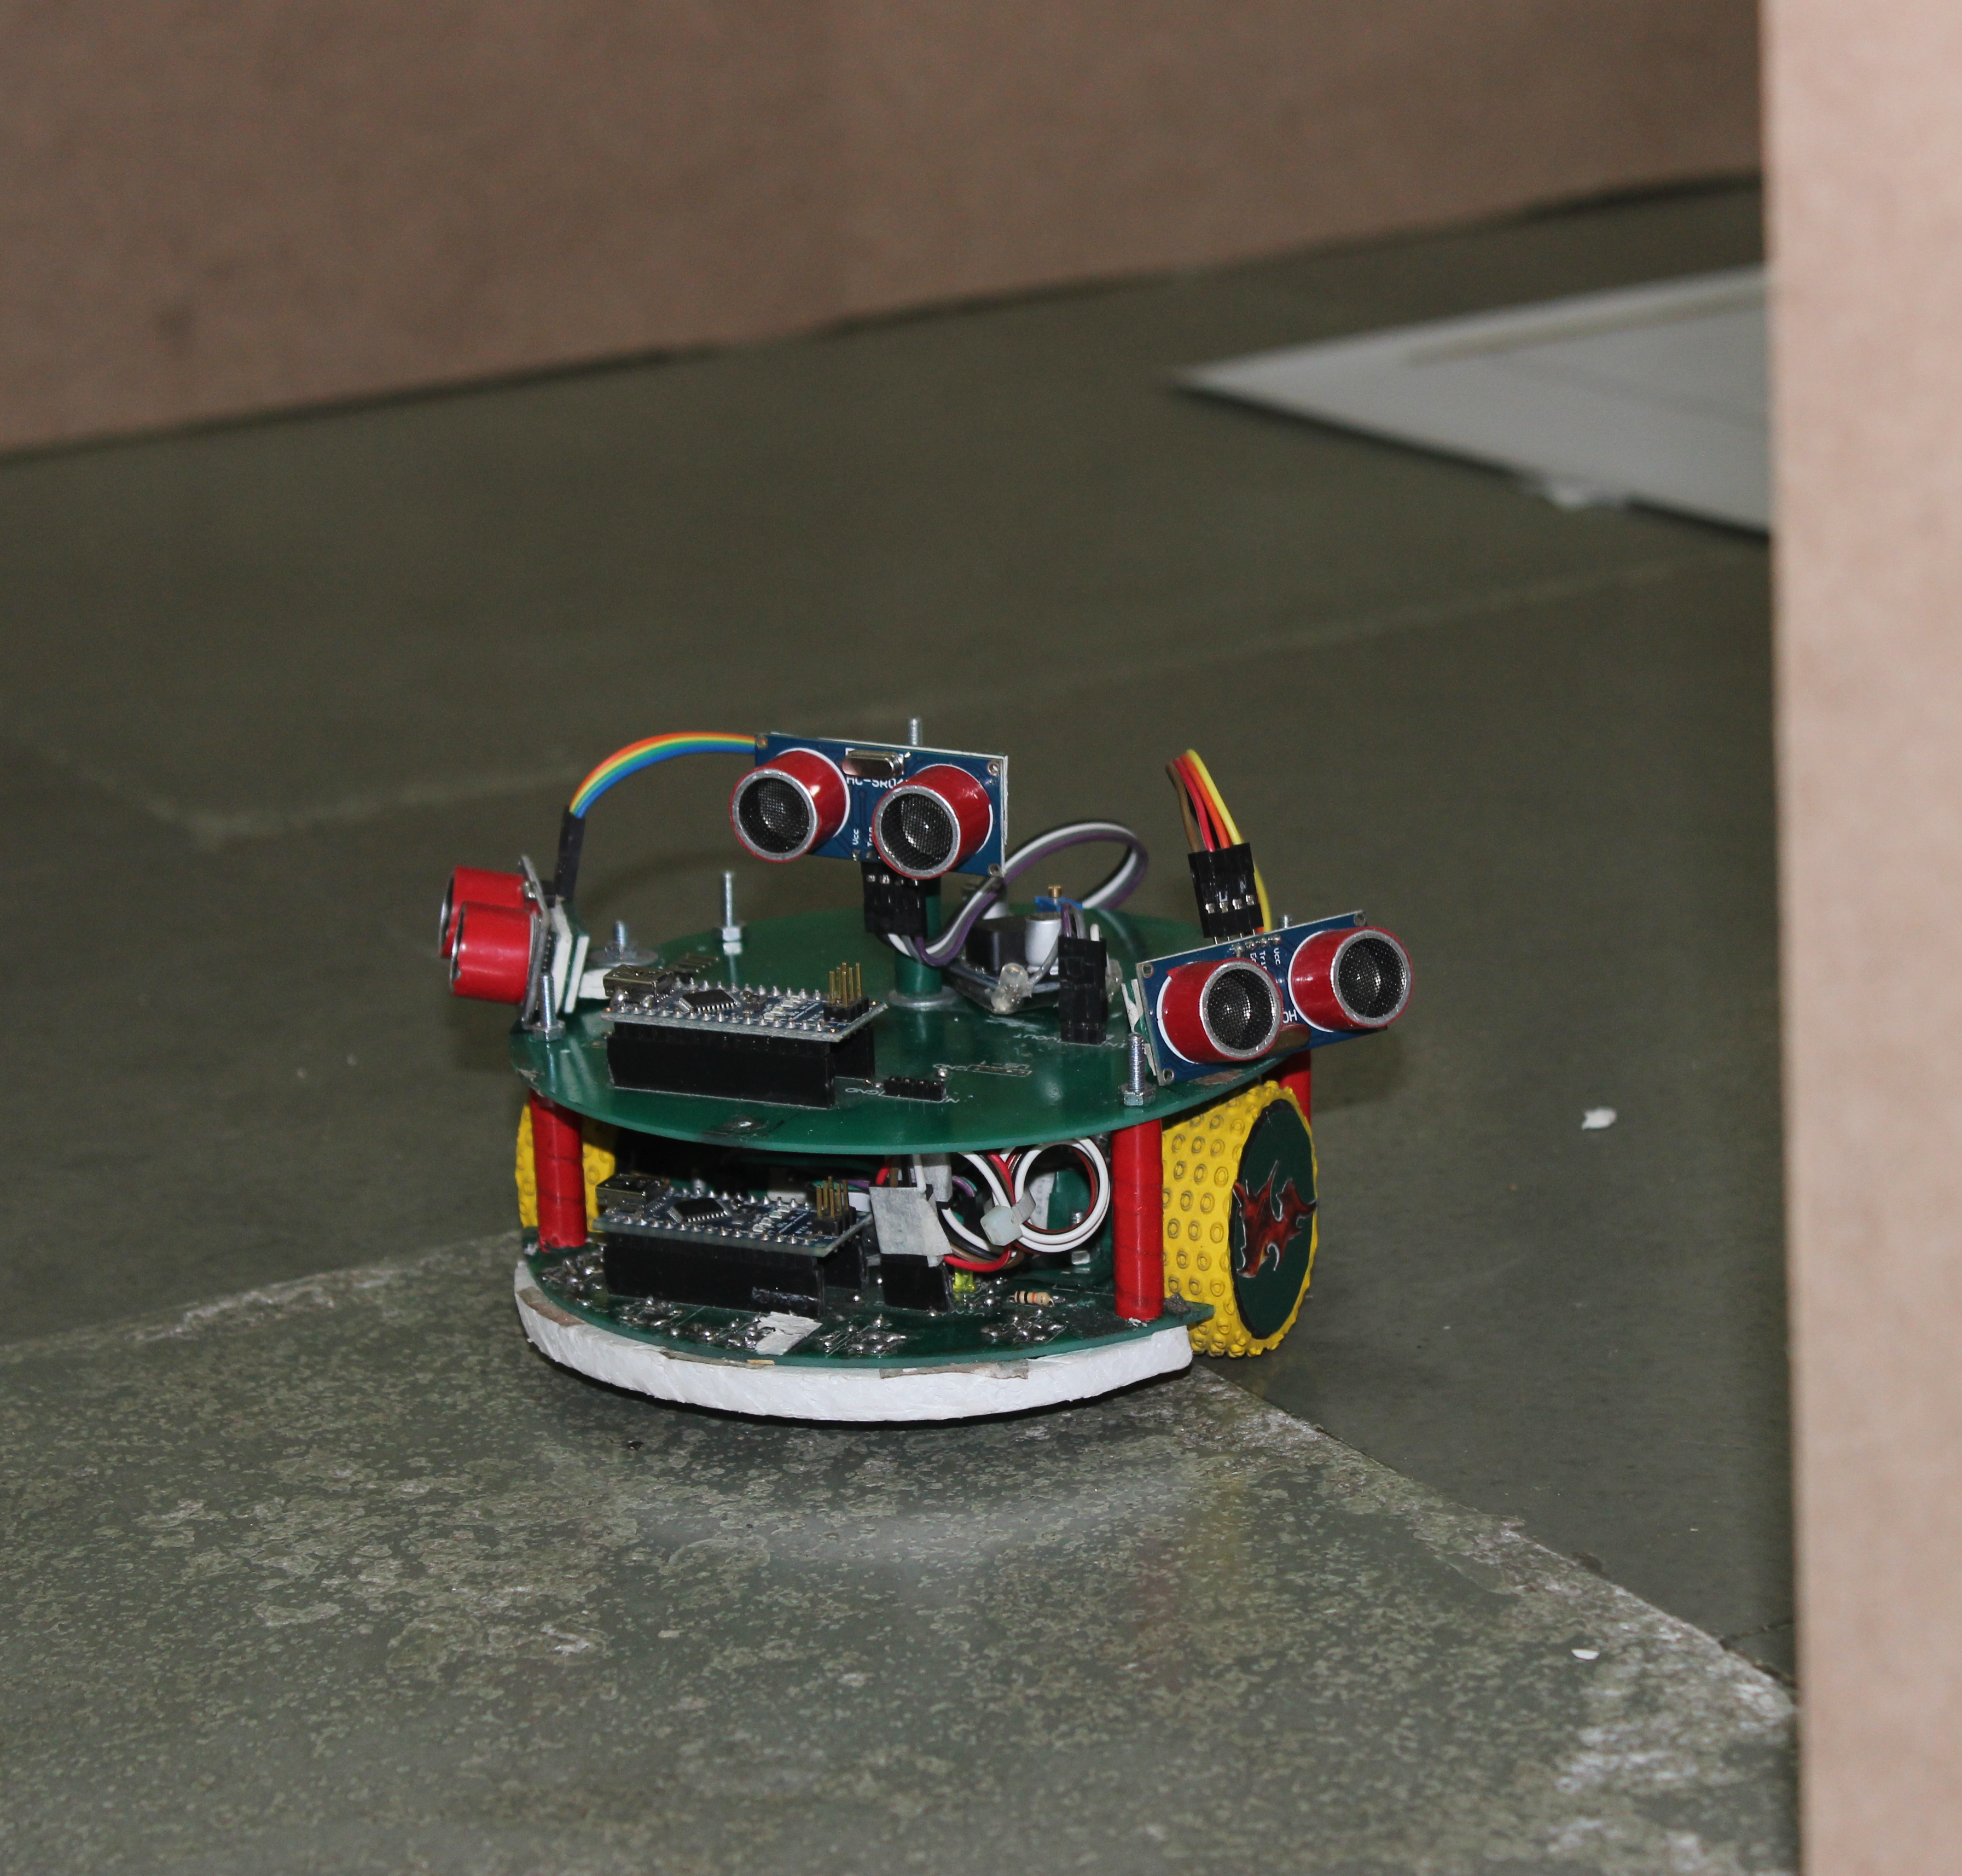
SEMINAR ON LINE FOLLOWER ROBOT

Slide 2
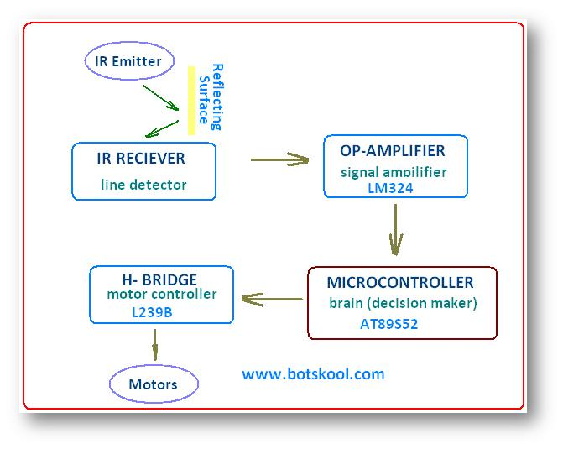
Analog
Value
L298N
Atmega 328

Slide 3
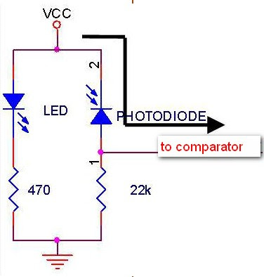
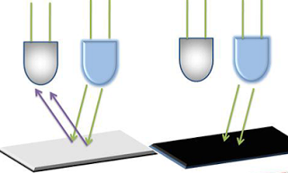
IR
SENSOR
IR RECEIVER
IR LED
RECEIVER
Signal
330
10K
LOW RESISTANCE
Of RECEIVER
HIGH RESISTANCE
Of RECEIVER

Slide 4
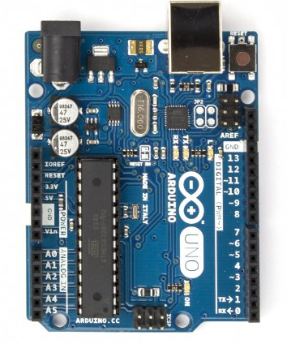
Programming
POWER INPUT FROM BATTERY
MICROCONTROLLER
ARDUINO UNO
5V & GND
Powering Up Sensors
Atmega 328
Pin A0-A4 From Sensors
Pin 2-7 to
Motor Controller

Slide 5
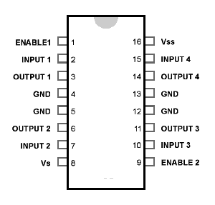
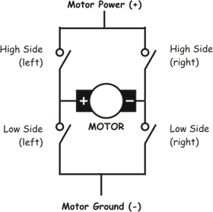
MOTOR
CONTROLLER

Slide 6
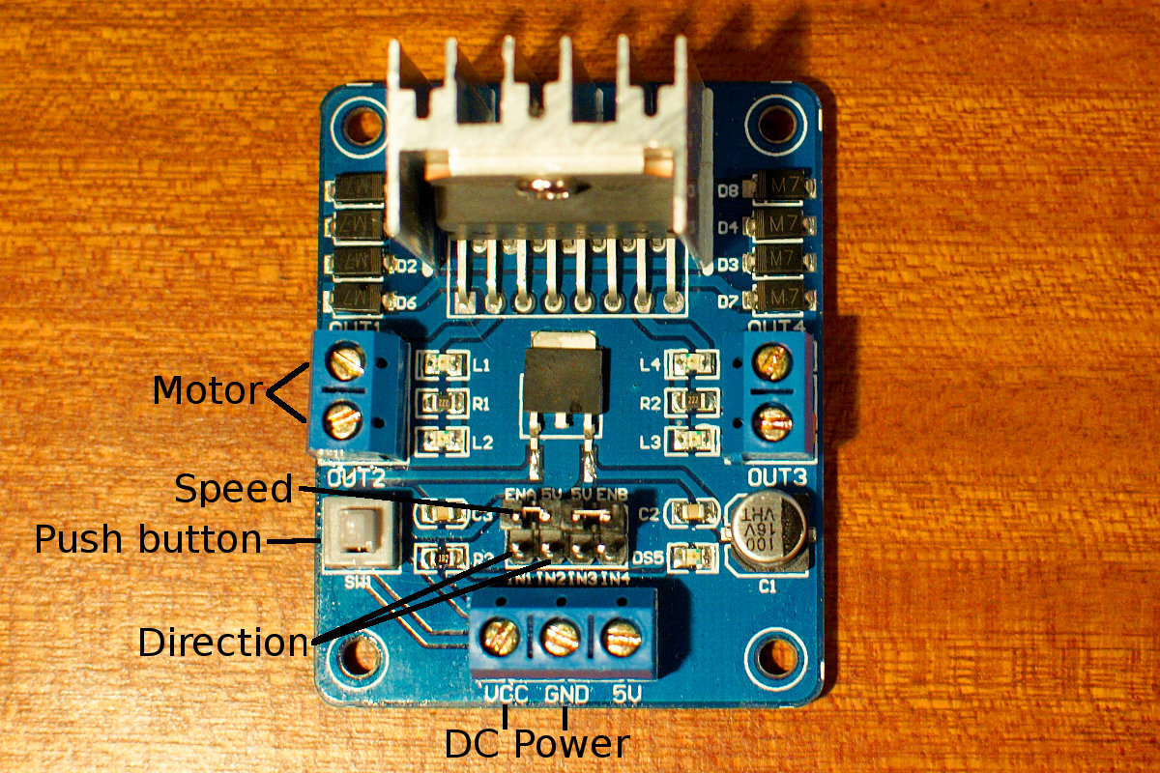
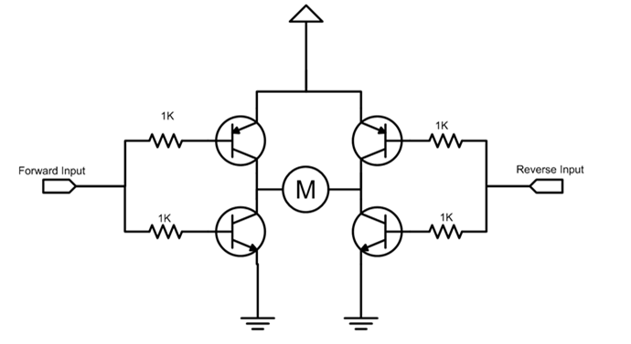
MOTOR
CONTROLLER
IN1
IN2
EN A

Slide 7
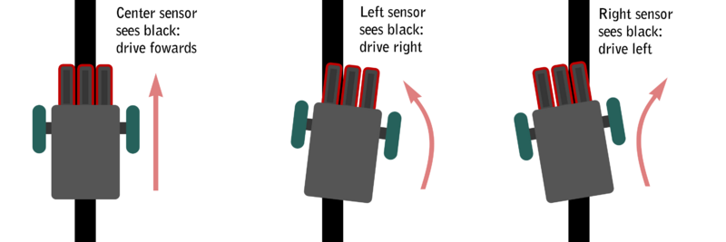

Slide 8
NO LINE

Slide 9
SENSOR ARRAY
On White S=0 On Black S=1
(S0X10)+(S1X20)+(S2X30)+(S3X40)+(S4X50)
ERROR=
- 30
S0+S1+S2+S3+S4
S0
S1
S2
S3
S4
-20
-15
-10
-5
0
5
10
15
20
ERROR

Slide 10
0 0 1 0 0 > ERROR=0; ON THE LINE
S0
S1
S2
S3
S4
-20
-15
-10
-5
0
5
10
15
20
0 1 1 0 0 > ERROR=-5
0 0 1 1 0 > ERROR=5
0 1 0 0 0 > ERROR=-10
0 0 0 1 0 > ERROR=10
1 1 0 0 0 > ERROR=-15
0 0 0 1 1 > ERROR=15
1 0 0 0 0 > ERROR=-20
0 0 0 0 1 > ERROR=20

Slide 11
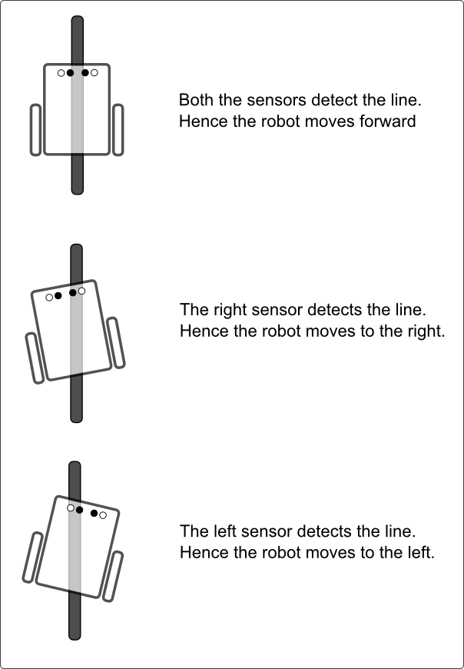
ERROR=0
ERROR>0
ERROR<0
LEFT MOTOR SPEED= LEFT BASE SPEED + CORRECTION
RIGHT MOTOR SPEED= RIGHT BASE SPEED - CORRECTION
BASE SPEED
CORRECTION

Slide 12
ERROR=0
ERROR>0
ERROR<0
CORRECTION= P+D
P=KP X ERROR
D=Kd X (ERROR-LAST ERROR)

